Slide 1

Research Question –
Tutorial Presentation for Feedback
Date:
Group Name: NO. A53 Name of Student Presenting: MOHSIN MAQSOOD ABBASI

Slide 2
The data that is analyzed is the Nobel Prize by winner, where each row has a laureate and has data on name, gender, country of birth, year of award and category of prize. Based on the documented year of birth and award year, we calculate the age of each of the laureates at the age at which he or she received the prize. In this paper, the data set has been filtered to contain only laureates in Physics and Chemistry groups and form a narrow sample that is appropriate to compare the trends of age with these two fields.
Dataset ID:
Notes:
Before specifying your Research Question you must define the type of data you are analysing. Are the variables you select interval data (measurement data you can divide, multiple, etc), OR are they ordinal (there is a definite order but the intervals between each variable are not necessarily equal, or the terms might be subjective like in a likert scale); OR are they just categorical/nominal (Items such as film names, cities, etc., that you can count numbers of occurrences? You also need to understand whether the variable is either dependent or independent and this will vary according to the context. Independent variables may cause an effect, whereas the dependent variable might be effected by the independent variable. Check the lecture notes on the RQ for more information and examples.
You will get only one opportunity to present your Research Question ahead of the submission date. Have your questions ready, and be ready to take notes on feedback.

Slide 3
“Is there a statistically significant difference in the mean age at which Nobel Prize laureates in Physics and Chemistry receive their awards?”
Null hypothesis (H0): μ_Chemistry = μ_Physics. There is no difference in the average age at which laureates in Physics and Chemistry receive the Nobel Prize.
Alternative hypothesis (H1): μ_Chemistry ≠ μ_Physics. The average age at award differs between Physics and Chemistry laureates.
Our Research Question is
Welch Two Sample t-test data: age_at_award by category t = 1.8582, df = 404.76, p-value = 0.06387 alternative hypothesis: true difference in means between group chemistry and group physics is not equal to 0 95 percent confidence interval: -0.1352178 4.8028384 sample estimates: mean in group chemistry mean in group physics 57.94211 55.60829

Slide 4
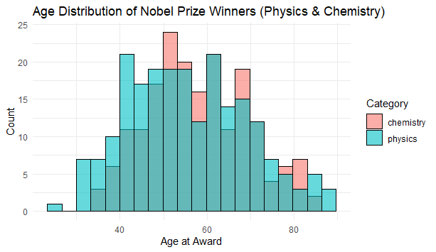

Slide 5
